Slide 1

Web-Based Ordering & Ingredient estimating for bakery Manufacturer
Final progress report presentation
Wednesday 23 January 2015
Miss. Nontra Mahachanont 542115026
Mr. Parinya Panyanak 542115034

Slide 2

agenda
Introduction
System Architecture
Project Status Report
Work list
Software Project Management Plan
Software Requirement Specification
Software Design
Software Implementation
Software Testing
Traceability Record
Demo
Problems

Slide 3
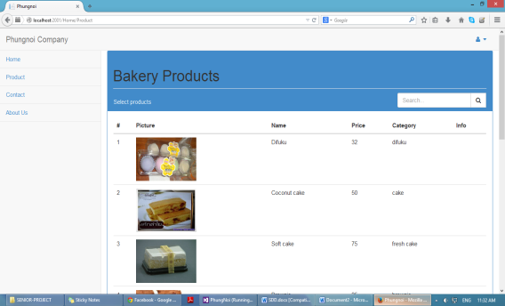
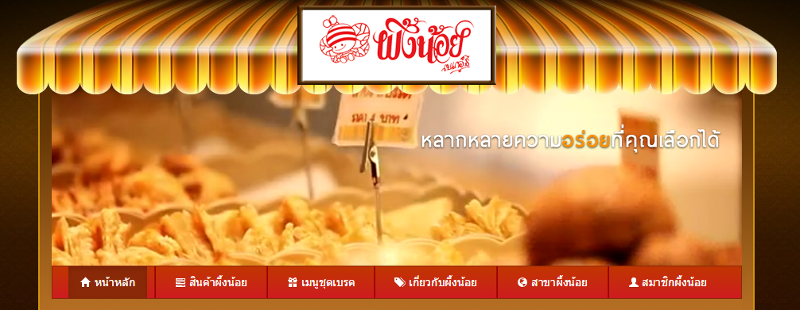


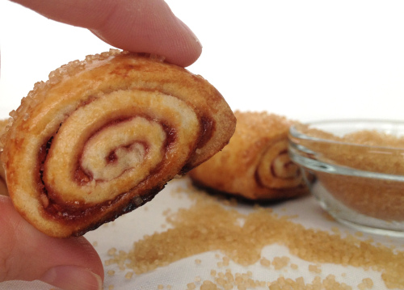
Introduction
Project is web application
Software for ordering bakery product
Software for estimating ingredient in the manufacturer
Develop by C# & ASP.NET MVC

Slide 4
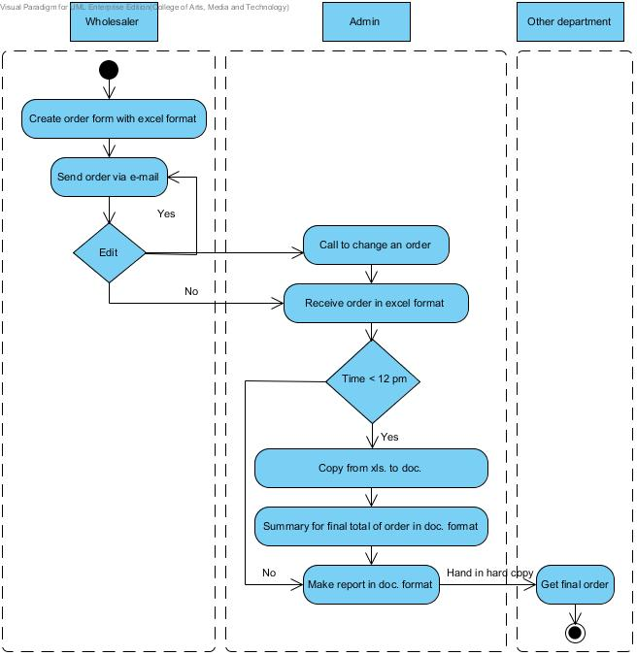
Traditional Workflow

Slide 5
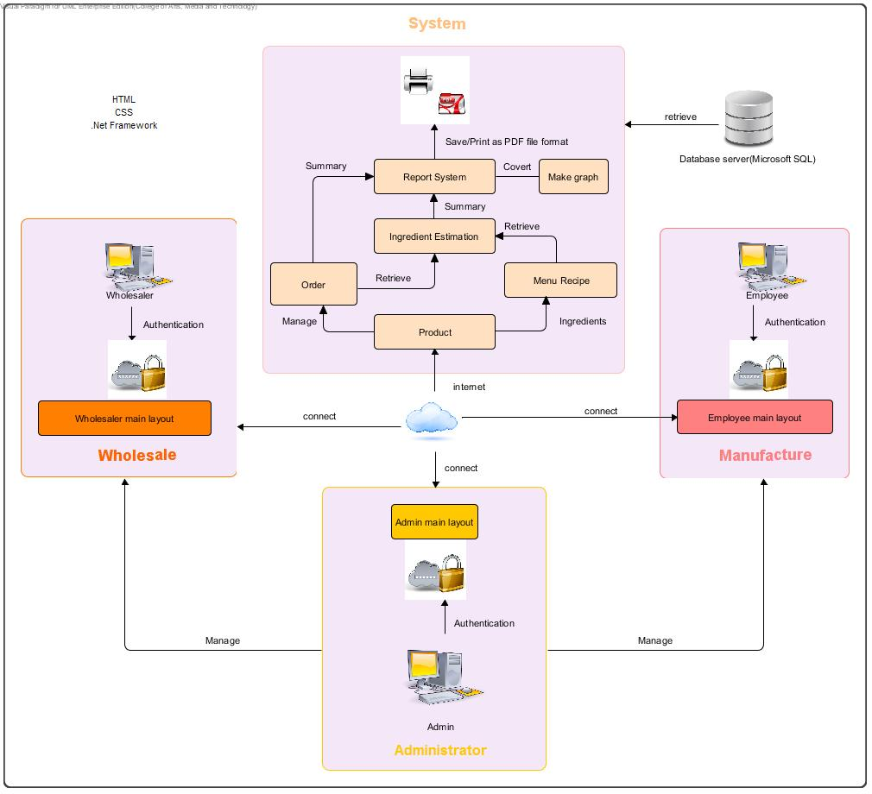
System architecture

Slide 6

Project status report
Project name: Web-based Ordering & Ingredient Estimating for Bakery Manufacturer
Prepared by: Nontra Mahachanont Parinya Panyanak | Date: 18 January 2015 |  | Report Process: Project Final Progress Report
Project Overall Status: 100 %
Feature: Ingredient Estimation and Report System - Admin can manage menu recipe information - Admin can view menu recipe information - Employee can view current’s ingredient estimation information - Employee can view previous ingredient estimation information - Employee and Wholesaler can make a report Wholesaler and Employee can make a graph
Milestone Deliverables performance reporting
Milestone Deliverables |  | Due Date | % Complete | Deliverable Status
Project Final Progress Report
Software Project Management Plan |  | 16 January 2015 | 100 % | On schedule
Software Requirement Specification |  | 16 January 2015 | 100 % | On schedule
Software Design Document |  | 16 January 2015 | 100 % | On schedule
Software Implementation |  | 16 January 2015 | 100 % | On schedule
Test Plan |  | 16 January 2015 | 100 % | On schedule
Test Record |  | 16 January 2015 | 100 % | On schedule
Traceability Record |  | 16 January 2015 | 100 % | On schedule

Slide 7

No. | Review Item | Responsibility | Reviewer
1 | Project Management Plan | NM | All members Advisor
2 | Project Proposal | All members | All members Advisor
 | Software Requirement Specification | NM | All members Advisor
3 | Software Design Document | PP | All members Advisor
4 | Implementation | PP | All members Advisor
 | Unit Test Report | PP | All members Advisor
5 | System Test Report | PP | All members Advisor
6 | Traceability Record | NM | All members Advisor
 | Project Status Report | NM | All members Advisor
 | Change Request | NM | All members Advisor
Work list in Final progress report

Slide 8
Tasks in Final Project Progress Report
Estimate Duration
Development Model
Change Management
Configuration Item Table
Repository Tool
Software project management plan

Slide 9
Estimate duration
Progress | Duration | Tasks
Proposal | Start: 07 February 2014 End: 02 April 2014 | Proposal Document
Progress Report I | Start: 15 April 2014 End: 13 August 2014 | Feature#1: Member Management Feature#2: Product Management
Progress Report II | Start: 18 August 2014 End: 29 October 2014 | Feature#3: Order Management Feature#4: Ingredient Management
Final Progress Report | Start: 18 November 2014 End: 16 January 2015 | Feature#5: Ingredient Estimation Feature#6: Report System

Slide 10
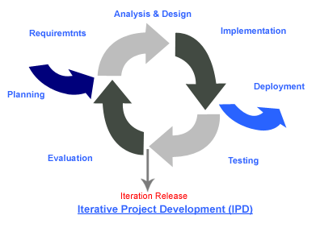
Development model
Iterative Software Development Process
We needed to develop the iterative way for review and improve the software and its documents for each development progress until it has finished.

Slide 11

Change management
No. | Item name | Baseline Version
1 | Project Proposal | 1.4
2 | Project Management Plan | 1.0
Specify version of each document.
Approving the change request by the project advisor.
URS UTC | URS - 01 | URS - 02 | URS - 03 | URS - 04 | URS - 05 | URS - 06
UTC - 01 |  | X
UTC - 02 |  |  |  | X
Create requirement traceability to trace change document.

Slide 12
No. | Item name | File name | File Type | Owner (Role) | Repository (Path) | Baseline Version
1 | Project Proposal | Web-based Ordering & Ingredient Estimating for Bakery Manufacturer – Project Proposal_V.1.4 | .docx | PP, NM | C:\Users\VAiO\Desktop\Senior Project\Project Plan | 1.4
2 | Project Management Plan | Web-based Ordering & Ingredient Estimating for Bakery Manufacturer – PMP_V.2.0 | .docx | PP, NM | C:\Users\VAiO\Desktop\Senior Project\PMP | 3.0
3 | Software Requirement Specification | Web-based Ordering & Ingredient Estimating for Bakery Manufacturer – SRS_V.2.0 | .docx | PP, NM | C:\Users\VAiO\Desktop\Senior Project\SRS | 3.0
4 | Software Design Document | Web-based Ordering & Ingredient Estimating for Bakery Manufacturer – SDD_V.2.0 | .docx | PP, NM | C:\Users\VAiO\Desktop\Senior Project\SDD | 3.0
5 | Test Plan | Web-based Ordering & Ingredient Estimating for Bakery Manufacturer – Test Plan_V.2.0 | .docx | PP, NM | C:\Users\VAiO\Desktop\Senior Project\Test Plan | 3.0
6 | Traceability Record | Web-based Ordering & Ingredient Estimating for Bakery Manufacturer – TR_V.2.0 | .docx | PP, NM | C:\Users\VAiO\Desktop\Senior Project\TR | 3.0
Software configuration item table

Slide 13
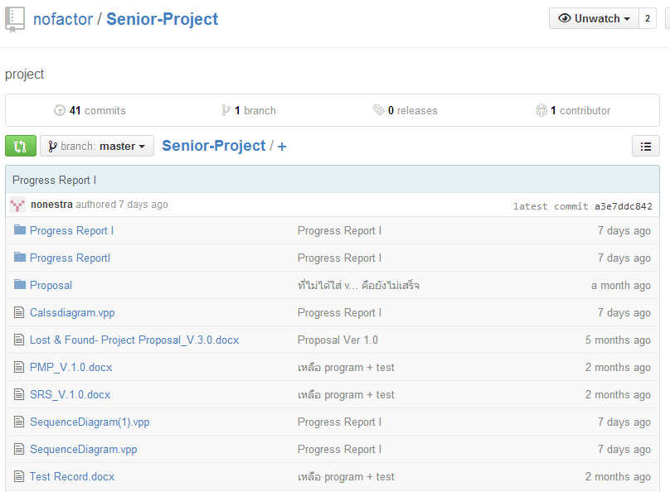

repository tool

Slide 14

Tasks in Project Final Progress Report
Analyze Requirement
Software Requirement Specification Document
26 User Requirement Specification (URS)
158 System Requirement Specification (SRS)
38 Activity Diagram (AD)
Software requirement specification

Slide 15
Example for URS
URS-25: Wholesaler and Employee can make a different report type according to their member’s role.
SRS-146: The system can connect to the phungnoi database and access Member, webpages_Roles, OrderDetail, and Recipe tables.
SRS-147: The system shall provide a button for making a report.
SRS-148: The system shall provide a report function to retrieve the summary information from the database.
SRS-149: The system shall provide a user interface to display the summary report contents on the report page.
SRS-150: The system shall provide a button for saving a summary report as a PDF file format from the report interface.
SRS-151: The system shall provide a service to export a summary report document out.
SRS-152: The system shall provide a button for printing a summary report as a documented paper.
Wholesaler side

Slide 16
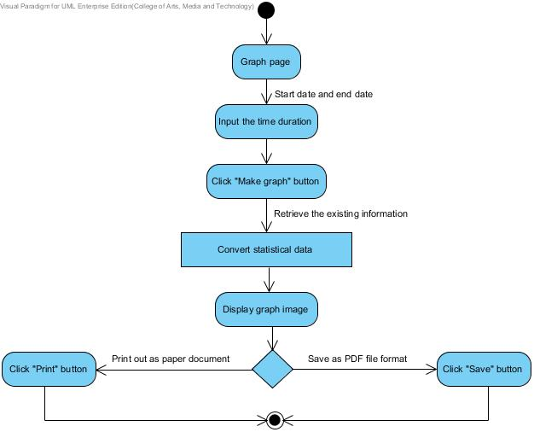
Example for activity diagram
AD - 38
Employee and Wholesaler make graph
Admin side

Slide 17
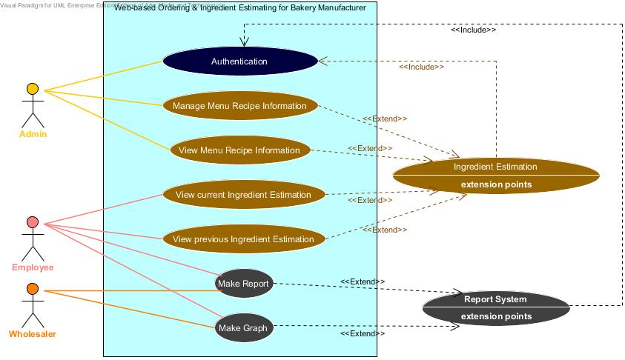
Requirement Analysis
Use Case
Scenario

Slide 18
Tasks in Project Fianl Progress Report
Class Diagram
Software Design Document
26 Sequence Diagram (SD)
28 User Interface Design (UI)
Database Design(DB)
Software design

Slide 19
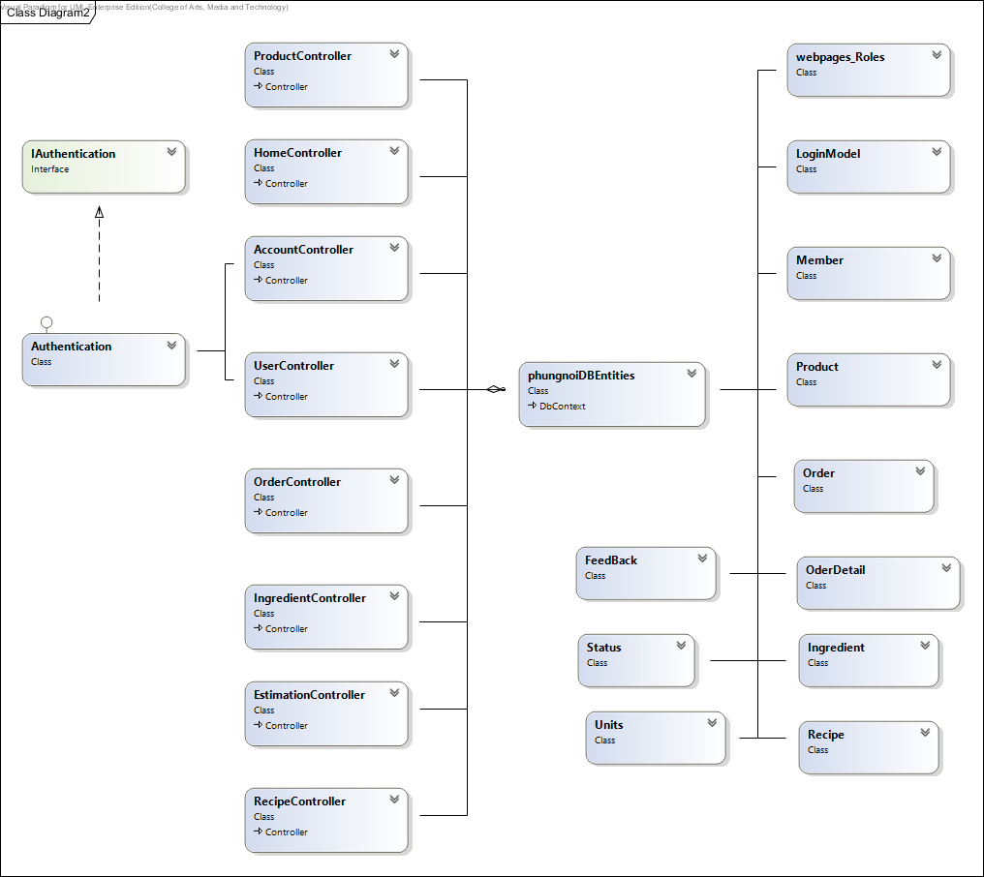
Example for class diagram

Slide 20
Example for
sequence diagram
SD – 24: Employee view previous ingredient information

Slide 21
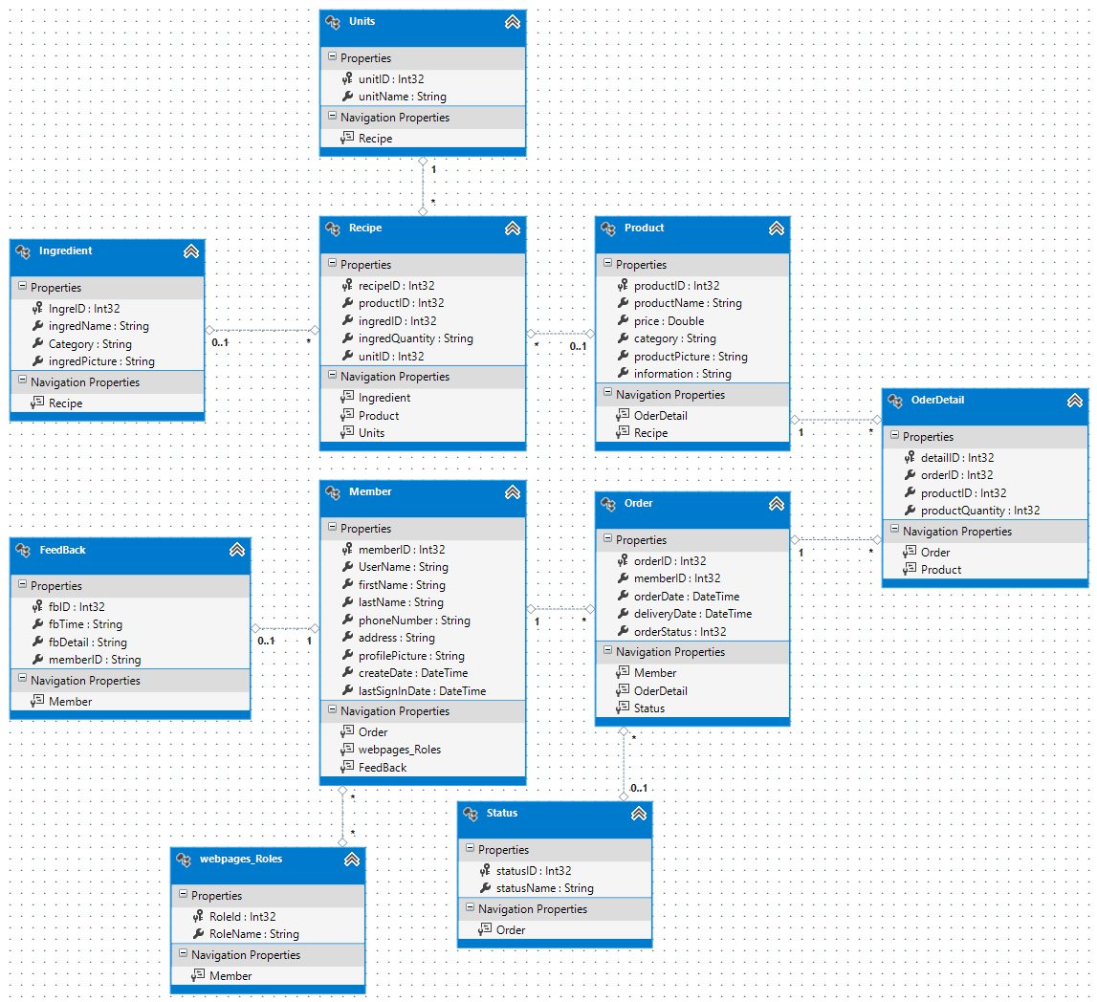
Example for database design

Slide 22
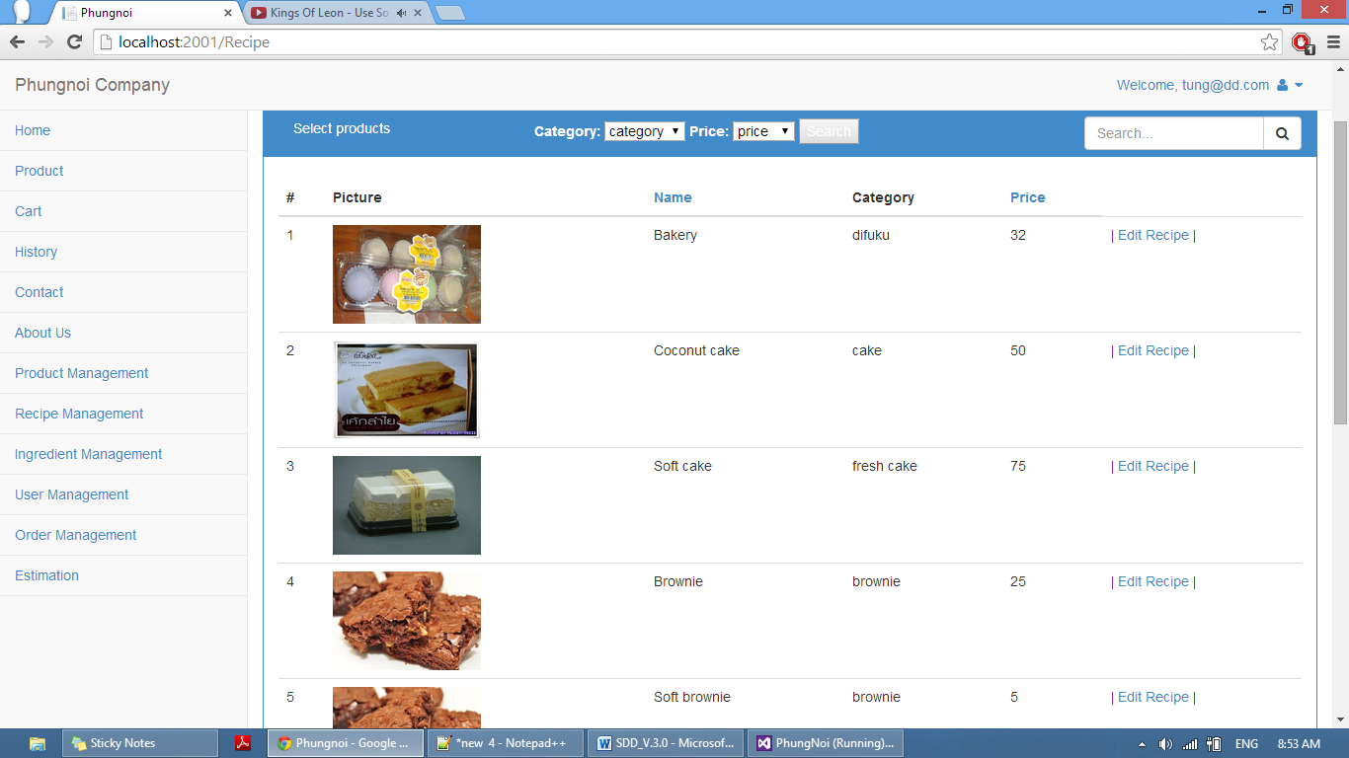
Example user interface
UI – 26: Menu Recipe page

Slide 23
Tasks in Project Final Progress Report
Developing Tools
Develop software comply with SRS & SDD
Ingredient Estimation
Report System
Software implement

Slide 24
Tasks in Project Final Progress Report
Test Plan Document
Test Plan
Test Record
Software testing

Slide 25
Example for unit testing
Unit Test Case-43(UTC-43): public ActionResult List(DateTime startPeriod, DateTime endPeriod)
Description: This unit test case used to check List () method that can select correct period and return to the correct page.
Test Cases:
No. | Description | Input | Expected output
1 | Test with input correct information | { startPeriod == 12/23/2014 12:00:00 AM, endPeriod == 1/23/2015 12:00:00 AM } | return View ("List ",List of order }
2 | Test with input incorrect information | { startPeriod == 20/01/2554 AM, endPeriod == 20/01/2555 12:00:00 AM } | return HttpNotFound ()

Slide 26
Unit Test Record
No. | Expected output | Actual output | Pass/Fail
1 | return View ("List ",List of order } | return View ("List ",List of order } | Pass
2 | return HttpNotFound () | return HttpNotFound () | Pass

Slide 27
Example for system testing
System Test Case-33 (STC-33): Employee can view all ingredient estimation history.
Description: This test case is a system testing for URS-24. Employee can view all ingredient estimation history by search the filter keyword of the delivery date in the database.
Prerequisite: Employee must login with the employee account.

Slide 28
No. | Description | Input | Expected output
1 | Test with clicks views ingredient estimation history on the ingredient estimation page. | - | Display the ingredient estimation history information on the ingredient estimation page.
2 | Test with valid information in the database | Search Box: 23 January 2014 | Found information and display ingredient estimation history information are related to the filter keyword.
3 | Test with invalid information in the database | Search Box: xxx | Not found ingredient estimation history information and display the not found message.
Test Cases

Slide 29
System Test Record
No. | Expected Result | Actual Result | Pass/Fail
1 | Display the ingredient estimation history information on the ingredient estimation page. | Display the ingredient estimation history information on the ingredient estimation page. | Pass
2 | Found information and display ingredient estimation history information are related to the filter keyword. | Found information and display ingredient estimation history information are related to the filter keyword. | Pass
3 | Not found ingredient estimation history information and display the not found message. | Not found ingredient estimation history information and display the not found message. | Pass

Slide 30
Example for Traceability Record Table
URS | Function Name | SRS | UI | SD | AD | UC | UTC | STC | DB
URS-24 | Employee view previous ingredient estimation. | SRS-31 SRS-139 SRS-140 SRS-141 SRS-142 SRS-143 SRS-144 SRS-145 | UI-04 | SD-24 | AD-36 | UC-22 | UTC-40 UTC-41 UTC-42 | STC -33 | DB-01 DB-04 DB-07 DB-08

Slide 31


Demo

Slide 32
Problems
Lack Writing English skills.
Bad communication between team members.
Requirements might be change.
Unit test case not enough.
Have a problem with sequence diagram
Deliverables delay.

Slide 33
Thank you for your attention

Slide 34
Q & A

